Slide 1
Krosh
Checkers against Classical Search
Group Members
Submitted to
Name : Adham Zarif
Id:0112330721
Name: Saber Hassan
Id:0112330870
Name : Sadia Islam
Id:0112330329
Kazi Fahim Tahmid
Lecturer, Dept of CSE
United International University
Course: CSE 3811 — AI Laboratory Section: A Group: 10
1 / 11

Slide 2
Contents
Introduction & Motivation
3
Alpha-Beta Baseline
8
System Architecture
4
Live Demonstration
9
Board Representation
5
Timeline Review
10
6
Greedy Baseline
Minimax Baseline
7
2 / 11

Slide 3
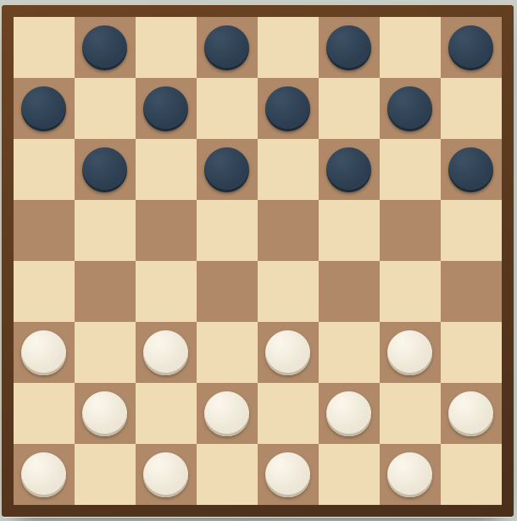
Introduction & Motivation
The Complexity of Adversarial Play
1.Branching factor
2.Multi-jump captures
3.King promotion
4.Per-move time budget
5.Zero-sum adversary
3 / 11

Slide 4
System Architecture
USER
Web UI · HTML + JS board
Flask HTTP endpoints · /new-game /move /undo /restart
Python Search Engines
Greedy
Minimax
Alpha-Beta
Static Board Evaluator (material · kings · position · mobility)
Chosen Move + Search Stats
Diagram 01: KROSH Architecture Diagram
4 / 11

Slide 5
Board Representation
The Game State
Table 01:Board Details
Board
Board
8×8 grid, 12 light + 12 dark pieces
Encoding
empty / light-man / dark-man / king
State
side-to-move · king mask · move number
Table 02:Game Rules
Rules
Movement
diagonal one-step on dark squares
Captures
leap over opponent, land on empty
Chains
multi-jump when further capture exists
Promotion
reach opponent's back row → king
5 / 11

Slide 6
Greedy Baseline
Greedy — One-Ply Best-First
Enumerate legal moves
Apply each move to a copy
Score with static evaluator
Pick argmax (tie-break: first)
Return move + node count = |M|
< 1 ms / move
No lookahead
6 / 11

Slide 7
Minimax Baseline
Minimax — Full-Depth Search
Root: current board state
Expand all legal moves
Recurse to depth d
Static eval at leaves
Back up min / max values
Return best move
Complexity: O(b^d) · depth-limited
7 / 11

Slide 8
Alpha-Beta Baseline
Alpha-Beta — Pruned Search
Windowed search: α = best score MAX can force
β = best score MIN can force
Prune when α ≥ β — the subtree can't change the answer.
MAX
MIN
MIN
MIN
3
12
×
×
14
×
×
8
3
Complexity: O(b^{d/2}) in the best case — same answer, deeper reach.
8 / 11

Slide 9
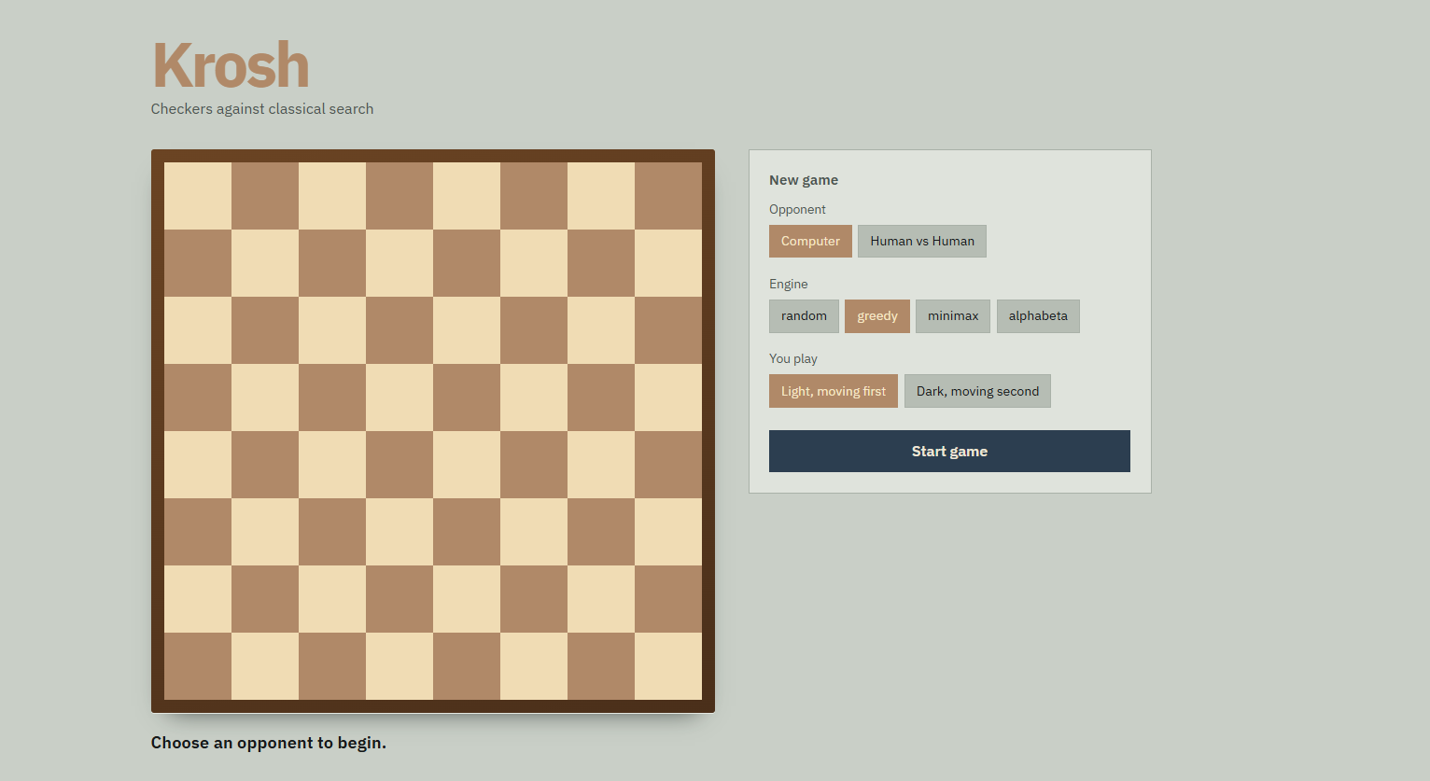
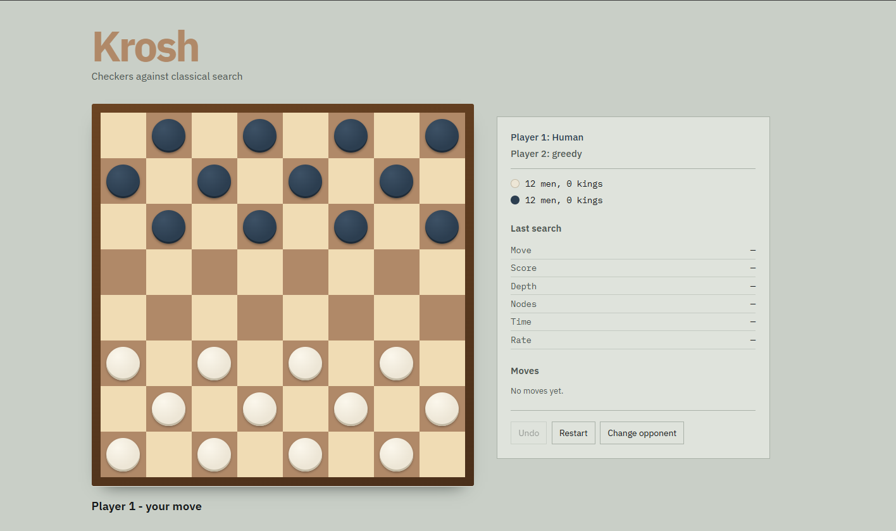
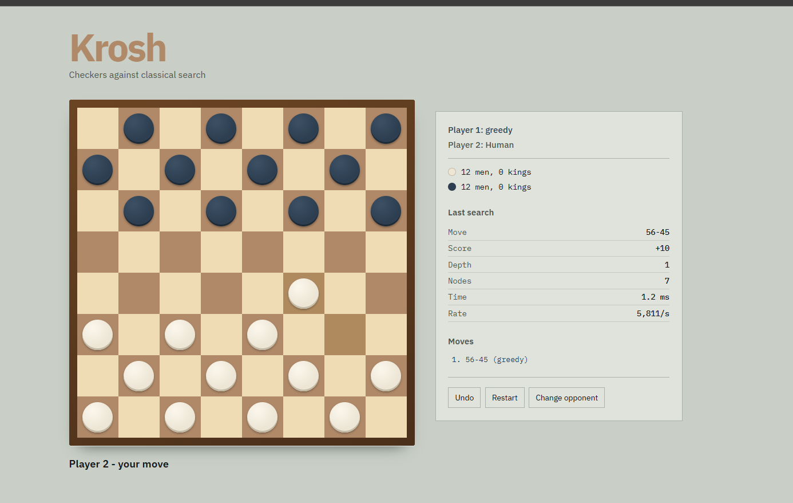
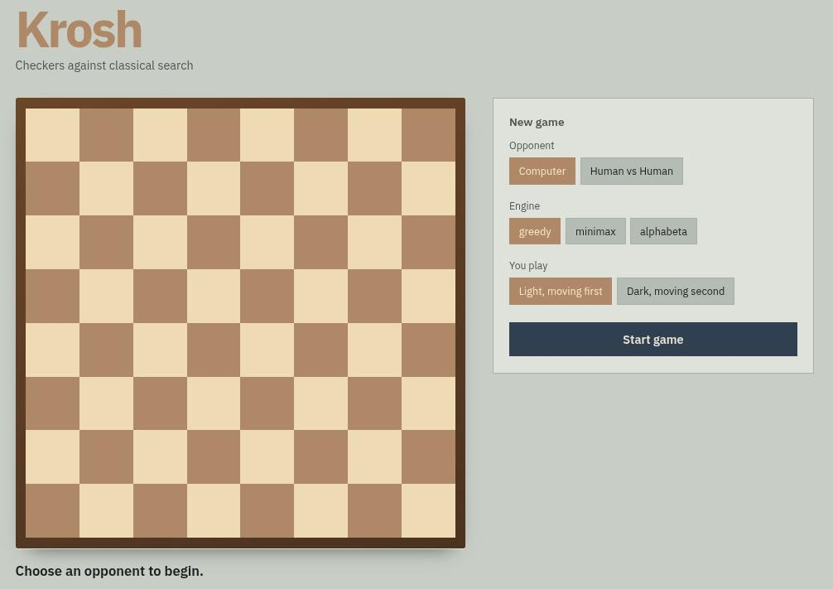
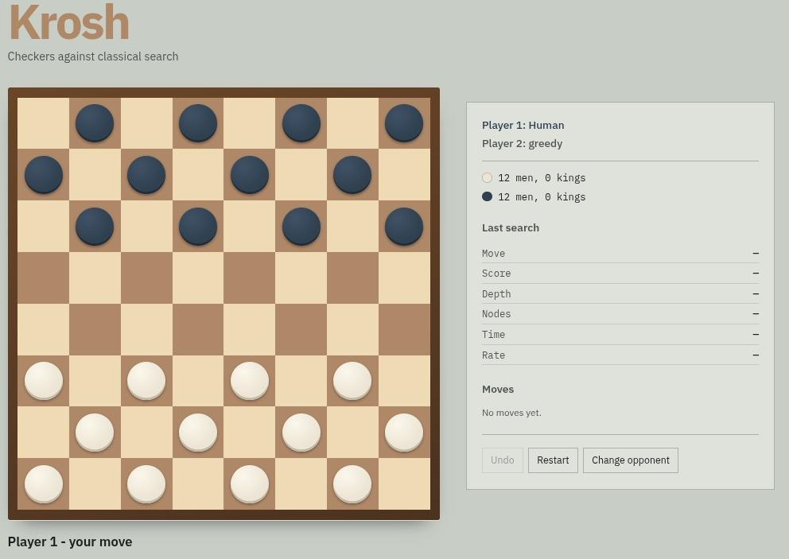
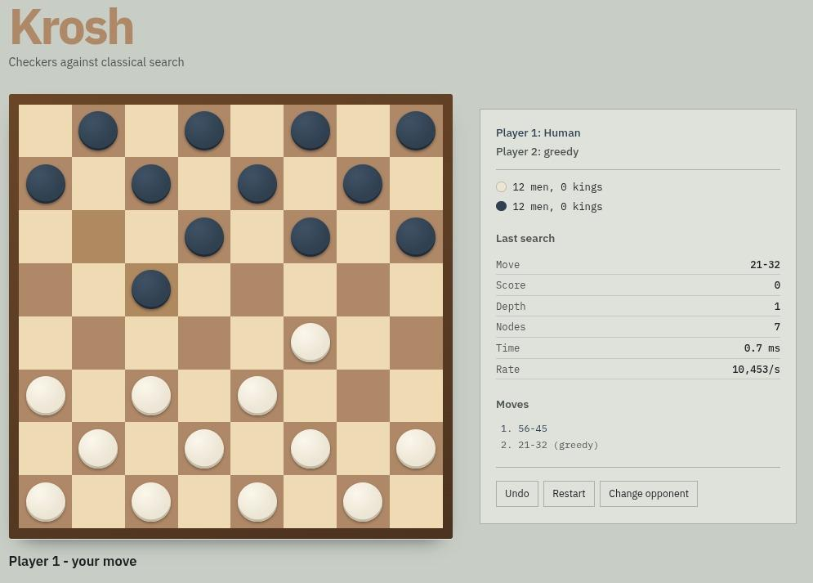
Live Demonstration
1 · New-Game Setup
2 · Starting Position
3 · Greedy Move Played
Choose opponent, engine (random / greedy / minimax / alpha-beta), and which colour plays first.
12 men each side, 0 kings. Sidebar tracks piece counts and search stats; Undo · Restart · Change opponent available.
Player 1 (greedy) plays 56-45 in 1.2 ms after visiting 7 nodes; move ledger and search stats update in real time.
9 / 11

Slide 10
Timeline Review
Phase 1: Build The Board
Phase 3: Add MinMax
Phase 5: MCTS
Phase 7: Human vs Human
Completed
Completed
Upcoming
Upcoming
Phase 2: Add Greedy
Phase 4: Add AlphaBeta
Phase 6: Hybrid Phase
Completed
Completed
Upcoming
10 / 11

Slide 11
Thank You
Any Questions?
11 / 11

